Slide 1

Piggy Bank
Empowering Your Financial Future
What is piggy bank ?
Piggy Bank is a savings web application that helps students develop good financial habits by setting aside small amounts of money for future goals.
Features of Piggy :
Transparency: Clear and detailed transaction history, allowing users to track their savings progress.
Free to Use: No charges or fees for using the application, making it accessible to everyone.
Anyone Can Access: User-friendly interface and minimal requirements, ensuring anyone with a smartphone can use the application.

Slide 2
4. Savings Tips and Reminders: Regular tips and reminders to help users stay on track with their savings goals.
5.Community Forum: Access to a community forum where users can connect with others, share tips, and learn from each other's experiences.
6.Social Sharing: Option to share savings progress on social media platforms, promoting accountability and motivation.
How our application is Useful for our future generation ?
Saving our money with Piggy Bank not only grows your wealth but also provides a clear picture of your financial progress, helping you identify areas for improvement and make smart decisions about your money.
Smart Money Management: How does Piggy Bank equip the next generation with smart money management skills, allowing them to navigate an increasingly complex financial landscape

Slide 3
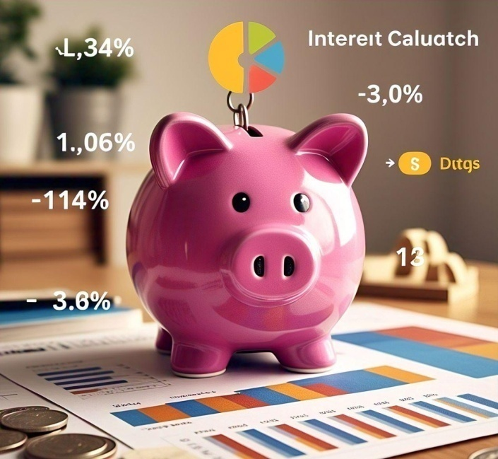
Financial Independence: What features of our application help young people achieve financial independence, enabling them to pursue their goals and dreams without financial stress
How we earn money from our application ?
Funding: Users deposit funds into their Piggy-Bank accounts
Investment: Piggy-Bank allocates these funds to partner companies, generating revenue through interest payments.
Interest Distribution: - Users: Receive 5% interest on their deposited funds, encouraging long-term savings.
- Developers: Earn 5% interest for maintaining and improving the application.
- Owners: Share 10% interest, incentivizing them to ensure the application's success.

Slide 4
Thank You
❤

